Slide 1
11-485/685/785, Fall 2024
HW2P2: Bootcamp
TAs: Syed Abdul Hannan, Hao Chen

Slide 2
Reflection of HW1P2
What was challenging but you figured that out?
Which strategies / resources helped you the most?
What would you do differently if you could start over?
Notes:
Give 5 mins to write down the answers

Slide 3

Reflection of HW1P2
What was challenging but you figured that out? → Great job
Which strategies / resources helped you the most? → Things to keep for HW2P2
What would you do differently if you could start over? → Things to change for HW2P2
Notes:
Give 5 mins to write down the answers

Slide 4
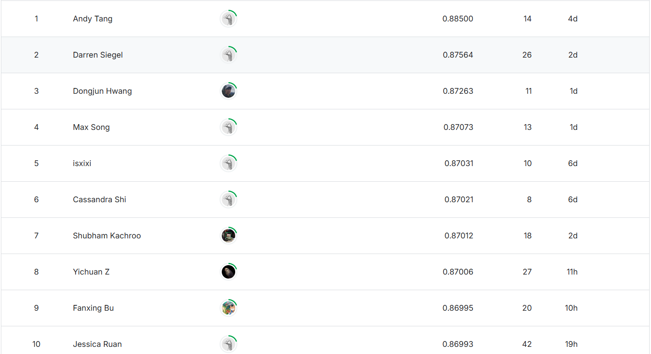

Kaggle shoutouts - top 10 submissions!

Slide 5
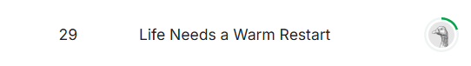
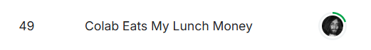

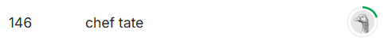
Kaggle shoutouts - most funny names!

Slide 6

Overview of HW2P2
HW2P2 is significantly more time consuming than HW1P2
Models will be harder to develop, train, and converge
Models must be written yourself and trained from scratch
Use what you learned from HW1P2 💪
Please start early!

Slide 7
Goal of this HW Bootcamp:
Help you to get started with HW2P2 🚀

Slide 8
Agenda
Problem statement
Workflow
Data loading and preprocessing
Building a model
Training, monitoring, testing, and Kaggle submission
Different loss functions for the task
FAQ

Slide 9
Problem statement

Slide 10
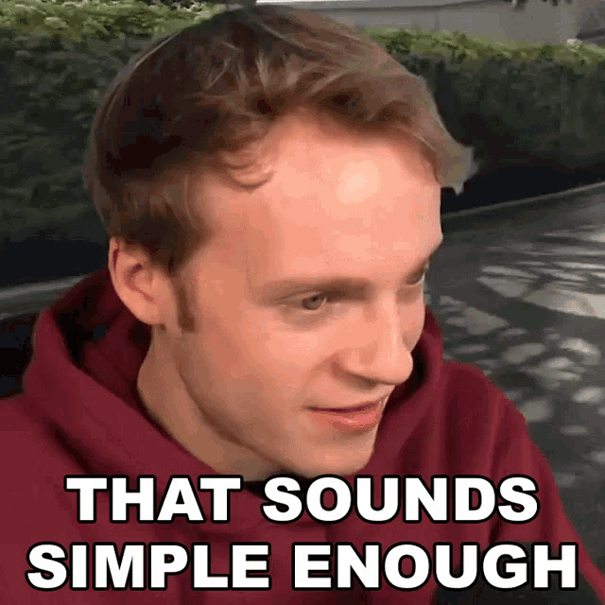
HW2P2 objective
Two tasks, one model, one submission
Face verification
Face classification

Slide 11
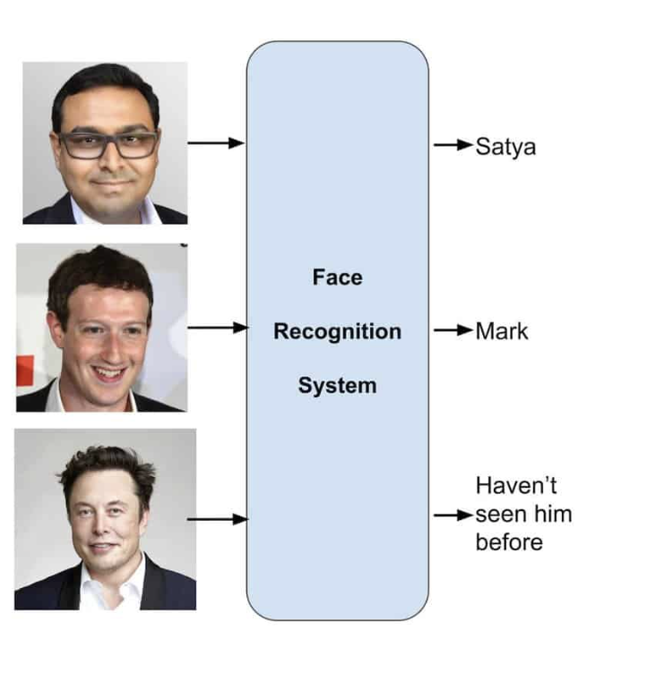
Face classification VS verification
Satya
Face classification
Mark
Haven’t seen it before
Face classification (aka identification, recognition)
Given an image, who is this person? Person X, Y, or Z
Example: can be used in applications like attendance system

Slide 12
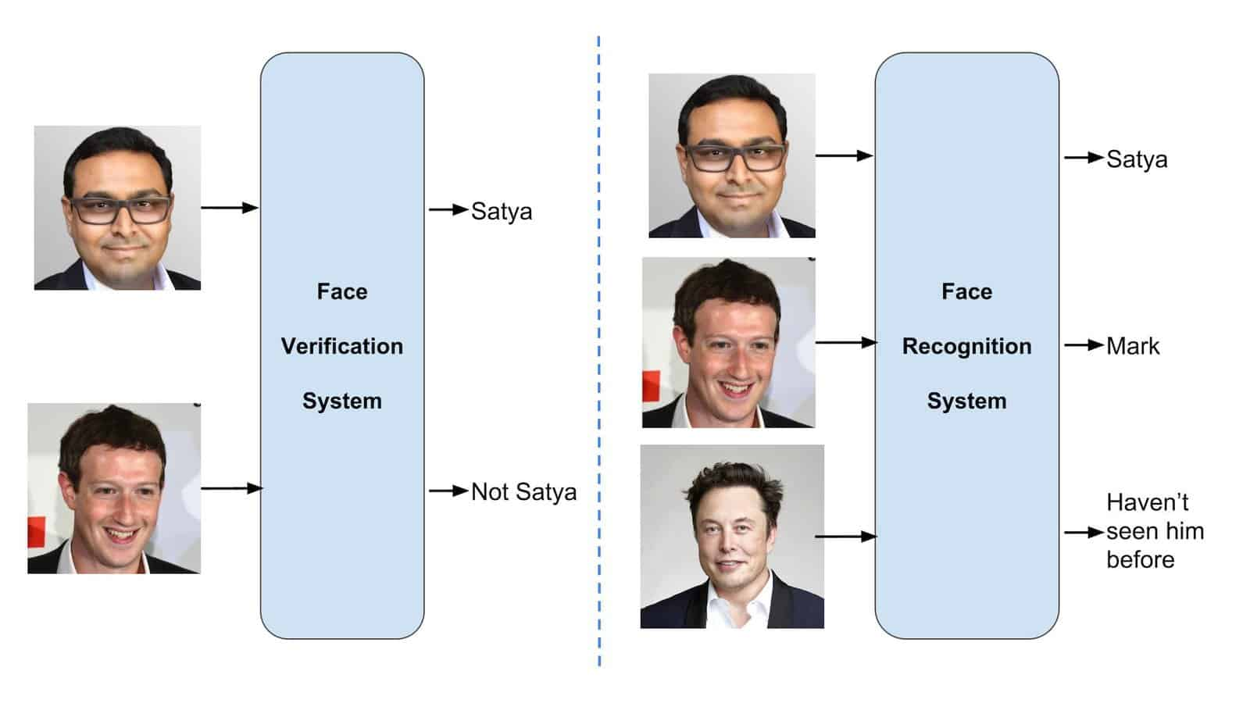
Face classification VS verification
Satya
Face classification
Mark
Haven’t seen it before
Face classification (aka identification, recognition) | Face verification
Given an image, who is this person? Person X, Y, or Z | Is the pair of Images given to you of the same person?
Example: can be used in applications like attendance system | Example: you can unlock your smartphone using your face, but others can’t

Slide 13
Workflow

Slide 14
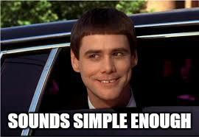
HW Parts 2 ideal workflow
Step 0: Download the notebook.
Step 1: Complete all #TODOs and ensure your code runs and reaches very low cutoff.
Step 2: Divide the experiments among the study group members to achieve the high cutoff.

Slide 15
HW Parts 2 components
1: Data loading and preprocessing
2: Building a model
3: Training and monitoring
4: Testing and Kaggle submission
5: Different loss functions and model finetuning

Slide 16
1. Data loading and Preprocessing

Slide 17
Dataset and DataLoader
1: We will be using the ImageFolder class from the torchvision library for classification. The images in subfolders of classification data are arranged in a way that is compatible with this dataset.
2: The ImageFolder class will automatically infer the labels and make a dataset object, which we can then pass on to the dataloader.
3: We will write our own dataset which returns a pair of images for verification.
Notes:
Implementing the Dataset and Dataloader class for this homework is actually very straightforward: we will be using the ImageFolder class from the torchvision library and passing it the path to the training and validation dataset.
The images in subfolders of classification data are arranged in a way that is compatible with this dataset class.
Since the folder names correspond to the classes and the images of respective classes are placed in folders with the same names, the ImageFolder class will automatically infer the labels and make a dataset object, which we can then pass on to the dataloader.
The only thing to remember is to also pass the image transforms to the dataset class for doing data augmentation.

Slide 18
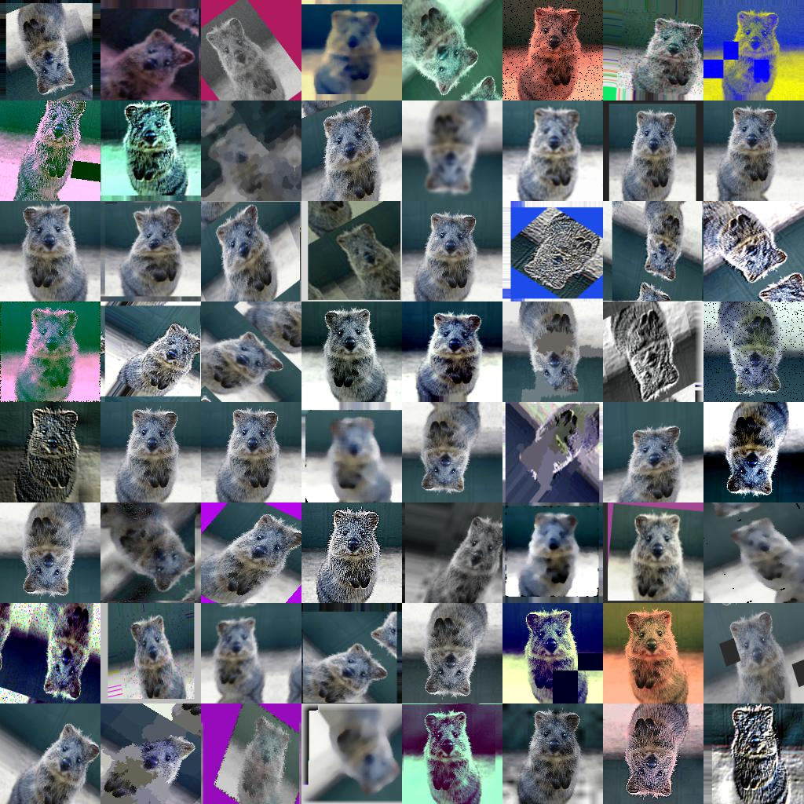
Image Augmentations

Slide 19
Why Do We Need Augmentations
1. Emulating More Data: Transformations increase the perceived dataset size by applying various alterations to input images, leading to improved training and generalization.
2. Preventing Overfitting: Transformations expose the model to ’new’ versions of images in every epoch, reducing the memorization of specific images and promoting the learning of robust features
3. Invariance: Training the model on transformed images teaches it to recognize objects independently of their orientation or position
4. Better Generalization: Transformations diversify the training set, exposing the model to a wide variety of examples, which can enhance performance on unseen data
Notes:
1. Emulating More Data: Transformations increase the perceived dataset size by applying various alterations to input images, leading to improved training and generalization.
2. Preventing Overfitting: Transformations expose the model to ’new’ versions of images in every epoch, reducing the memorization of specific images and promoting the learning of robust features
3. Invariance: Training the model on transformed images teaches it to recognize objects independently of their orientation or position
4. Better Generalization: Transformations diversify the training set, exposing the model to a wide variety of examples, which can enhance performance on unseen data

Slide 20
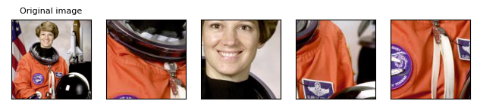
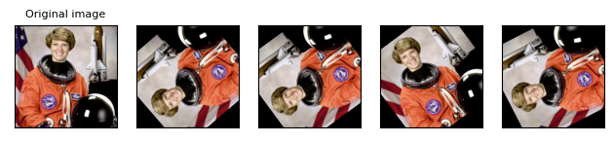
Sample Augmentations
Random Crop
Random Rotation

Slide 21
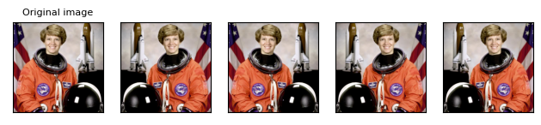
Random Horizontal Flip
Good Transform
Notes:
However, it’s important to note that while transformations can be very beneficial, they should be chosen carefully. There are potential downsides to using image transformations. These include increased training time, the risk of inappropriate transformations depending on the context, possible distortion or loss of information, the need for careful parameter choice, and not entirely resolving overfitting issues, especially in cases of very small datasets or complex models.

Slide 22
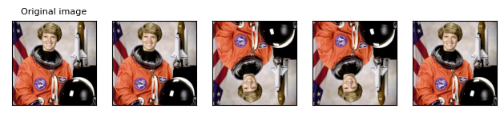
Random Vertical Flip
Not So Good Transform
Notes:
Also, transformations should reflect the types of variation you expect in your real-world data. For example, if you’re working with images of faces, using vertical flips as a transformation may not make much sense, since upside-down faces are relatively rare in real-world scenarios.

Slide 23
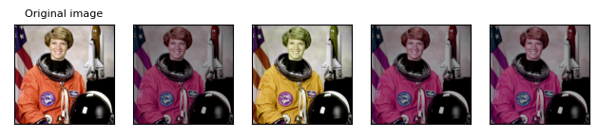
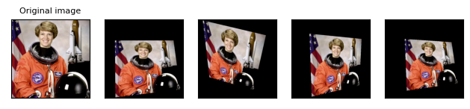
Sample Augmentations
Color Jitter
Random Perspective

Slide 24
Transformation Tips
Consider Normalising the Data:
- Use torchvision.transforms.Normalize() after calculating the mean and standard deviation of each pixel of each image of the dataset over all 3 channels(RGB)
Common Issue:
TypeError: Input tensor should be a torch tensor. Got <class 'PIL.Image.Image'>.
- Please check the sequencing of your transforms. Read the documentation and verify the kind of input required.
Notes:
Normalizing images is a useful or important step before training a deep learning model because it can improve the performance and stability of the model.
Normalizing images means scaling them to have the same size and range of values, usually between 0 and 1.
This can help the model learn faster and more accurately from the data, as it reduces the variation and noise in the input features.
Normalizing images can also prevent some numerical issues that might arise from using large or small pixel values, such as floating-point precision errors or gradient vanishing or exploding.

Slide 25
This Is What A Typical Transform Pipeline Could Look Like:
transforms = transforms.Compose([
transforms.Random_____(112),
transforms.Random_____(),
transforms.ToTensor(),
transforms.Normalize([0.5, 0.5, 0.5], [0.5, 0.5, 0.5])
])
Torchvision Transforms Illustrations URL:
https://pytorch.org/vision/0.11/auto_examples/plot_transforms.html#sphx-glr-auto-examples-plot-transforms-py

Slide 26
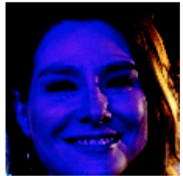
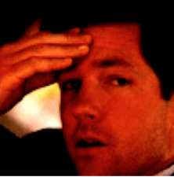
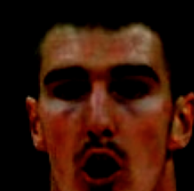
Final Images After Transformation (After applying Augmentations)

Slide 27


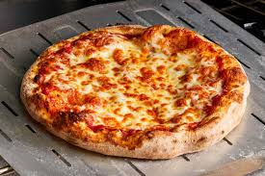

WE MIGHT HAVE A PROBLEM IF IT LOOKS LIKE THIS!!

Slide 28
2. Building a model

Slide 29

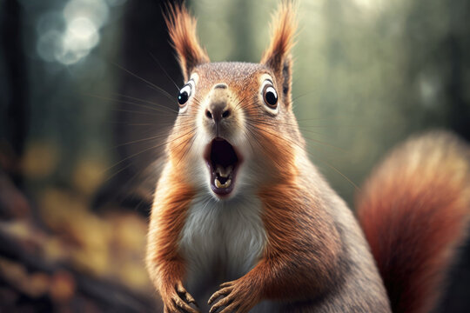
WHY NOT USE LINEAR LAYERS???

Slide 30
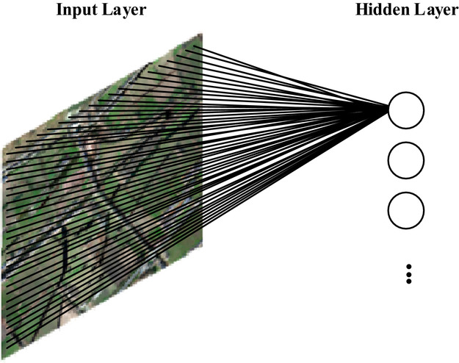
HINT: For a 1000 x 1000 image
With 1 M Hidden Neurons.

Slide 31

HINT: For a 1000 x 1000 image
With 1 M Hidden Neurons.
That is 10^12 M Trainable Parameters
We Also Lose Spatial Features
Rather use something else…

Slide 32
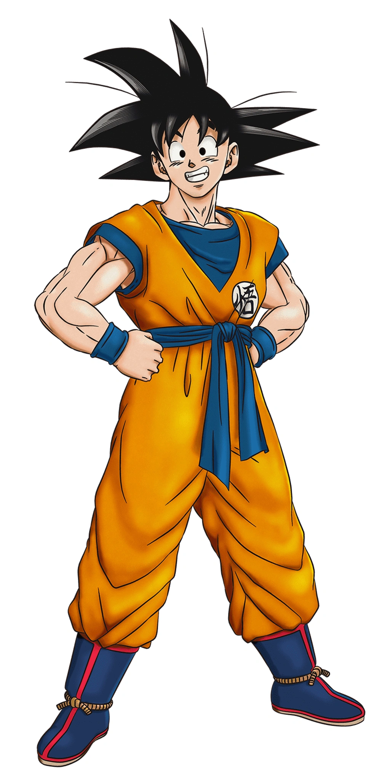

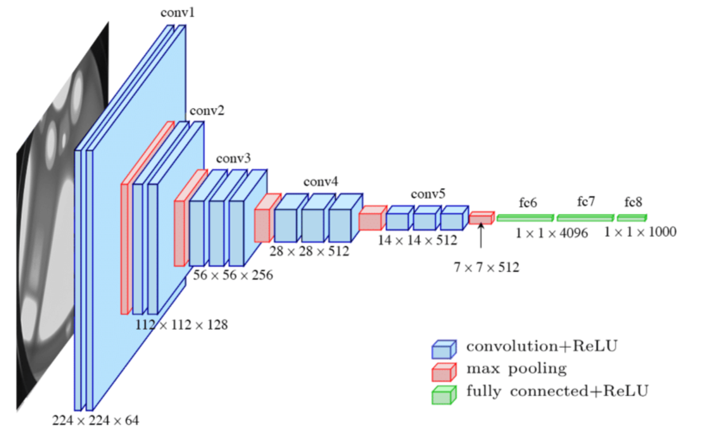
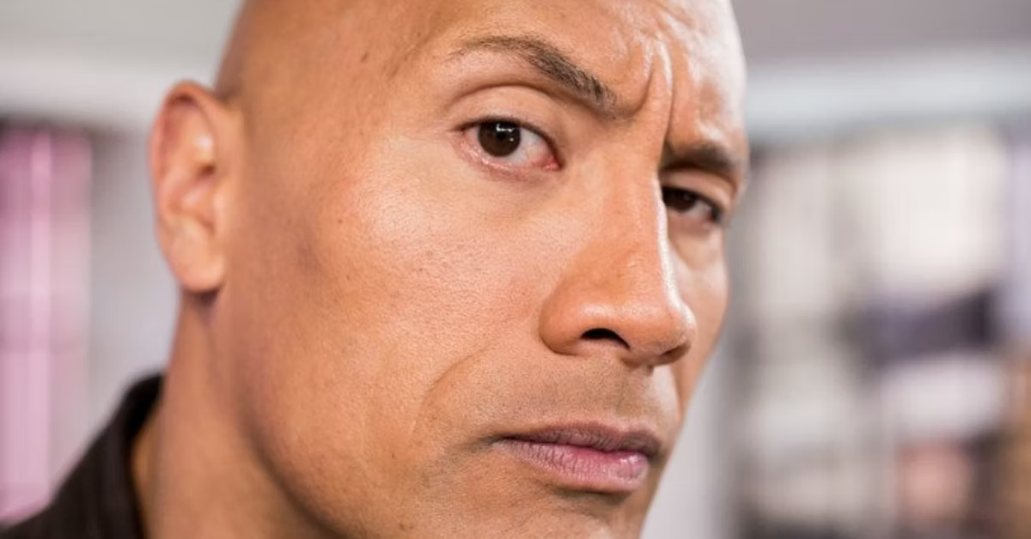
OUR HERO: CNNs
BUT WHY?????

Slide 33

CNN
They are good in capturing spatial patterns (can handle 2D images)
Good at feature detection.
They share parameters across local region, reducing number of parameters
Translational Invariance

Slide 34


BUT ONLY CNN’S ARE NOT ENOUGH

Slide 35
NEED MORE COMPLEX ARCHITECTURES WITH DIFFERENT WAYS TO CONVERGE THE MODEL AND MITIGATE OVERFITTING

Slide 36
GOOD MODELS (*for this homework)
RESNET
SE-RESNET
(ANY MAGICAL ARCHITECTURE)

Slide 37

LET’S TALK ABOUT RESNETS

Slide 38
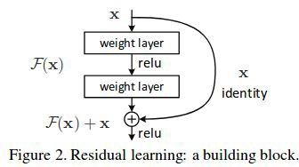

ResNet
To Convert Paper -> Code [understand the blocks + main aspects]
ResNet Blocks: [Basic Blocks and Bottleneck Blocks]
ResNet Main Aspect: Residual Connections

Slide 39
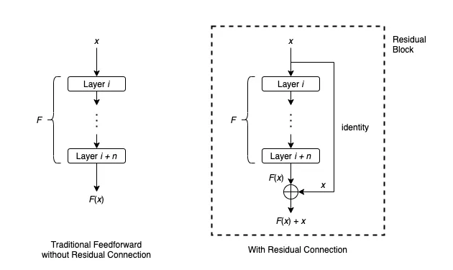
Residual Connections
In traditional feedforward neural networks, data flows through each layer sequentially: The output of a layer is the input for the next layer.
Residual connection provides another path for data to reach latter parts of the neural network by skipping some layers.

Slide 40
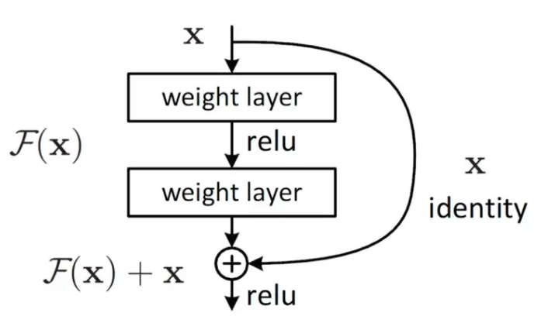
How do they help??
For feedforward neural networks, training a deep network is usually very difficult, due to problems such as exploding gradients and vanishing gradients.
On the other hand, the training process of a neural network with residual connections is empirically shown to converge much more easily, even if the network has several hundreds layers.
Without Residual Connections, the gradients (signal for learning) get weaker as they flow backward to these layers.

Slide 41
Residual Connections
The residual connection first applies identity mapping to x
Then it performs element-wise addition F(x) + x.
The whole architecture that takes an input x and produces output F(x) + x is usually called a residual block or a building block.
Quite often, a residual block will also include an activation function such as ReLU applied to F(x) + x.

Slide 42
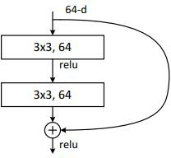
ResNet: BasicBlock
It’s just a regular 3x3 convolution (then BN, ReLU), another 3x3 convolution (then BN).
Then, a skip connection adding input and output, then ReLU.

Slide 43
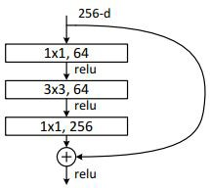
ResNet: Bottleneck Block
A bit more involved.
A 256-channel input goes through a point-wise convolution, reducing channels to 64.
Then, a 3x3 regular convolution maintains channels at 64.
Then, a point-wise convolution expands channels back to 256.
Finally, the residual connection.

Slide 44
Residual Connection - Basic Block
class BasicBlock(torch.nn.Module):
def __init__(self, n_h):
self.linear0 = torch.nn.Linear(n_h, n_h)
self.linear1 = torch.nn.Linear(n_h, n_h)
self.bn0 = torch.nn.BatchNorm1d(n_h)
self.bn1 = torch.nn.BatchNorm1d(n_h)
self.relu = torch.nn.ReLU(inplace=True)
def forward(self, A0):
R0 = A0
Z0 = self.linear0(A0)
BZ0 = self.bn0(Z0)
A1 = self.relu(BZ0)
Z1 = self.linear1(A1)
BZ1 = self.bn1(Z1)
A2 = self.relu(BZ1 + R0)
return A2

Slide 45
Residual Connection - Bottleneck Block
class Bottleneck(torch.nn.Module):
def __init__(self, n_h):
self.residual = torch.nn.Linear(n_h, n_h*4)
self.linear0 = torch.nn.Linear(n_h, n_h )
self.linear1 = torch.nn.Linear(n_h, n_h )
self.linear2 = torch.nn.Linear(n_h, n_h*4)
self.bn0 = torch.nn.BatchNorm1d(n_h )
self.bn1 = torch.nn.BatchNorm1d(n_h )
self.bn2 = torch.nn.BatchNorm1d(n_h*4)
self.relu = torch.nn.ReLU(inplace=True)
def forward(self, A0):
R0 = self.residual(A0)
Z0 = self.linear0(A0)
BZ0 = self.bn0(Z0)
A1 = self.relu(BZ0)
Z1 = self.linear1(A1)
BZ1 = self.bn1(Z1)
A2 = self.relu(BZ1)
Z2 = self.linear2(A2)
BZ2 = self.bn2(Z2)
A3 = self.relu(BZ2 + R0)
return A3

Slide 46
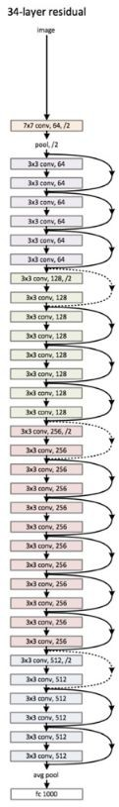
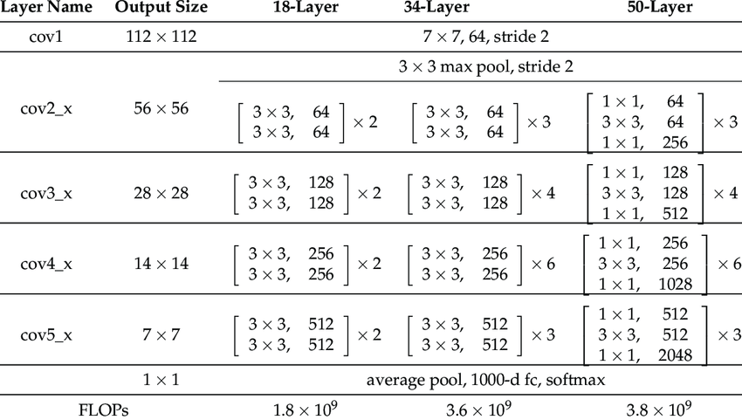
ResNet: Overall Architecture

Slide 47


AHHHHHHHHHH

Slide 48
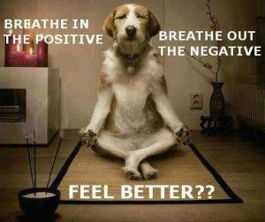
BREATHE!!!!

Slide 49
General Architecture Flow
CNN architectures are divided into stages, which are divided into blocks.
Each “stage” consists of (almost) equivalent “blocks”
Each “block” consists of a few CNN layers, BN, and ReLUs.
To understand an architecture, we mostly need to understand its
blocks.
All that changes for blocks in different stages is the base # of channels

Slide 50
ConvNeXt
This is a very new paper, a state-of-the-art architecture.
However, its intuitions are very similar to MobileNetV2.
Again, remember that to understand a paper, we just really need to understand its blocks.
Just a single block type for ConvNeXt
Read the paper for details on stages/channel sizes, etc.
We recommend ConvNeXt-T size which has less than 35M parameters.

Slide 51
General Architecture Flow
However, you do need to piece these blocks together into a final model.
The general flow is like this:
Stem
Stage 1
Stage 2
…
Stage n
Classification Layer
STEM
STAGE
BLOCK
FC/ CLASSIFICATION LAYER

Slide 52
Summary
A normal convolution mixes information from both different channels and different spatial locations (pixels)
A depth-wise convolution only mixes information over spatial locations
Different channels do not interact.
A point-wise convolution only mixes information over different channels
Different spatial locations do not interact

Slide 53
3. Training, monitoring, testing, and Kaggle submission

Slide 54
Monitoring Training vs Validation Acc
The standard intuition of “overfitting” is – if the training & validation gap is too large, you should stop training as it’s overfitting.
However, in modern DL, this intuition is not as relevant.
XELoss != Accuracy
Model can keep improving after training accuracy hits 100%.
There is recent research that finds that on some problems, training accuracy hits 100% at epoch 10 while validation accuracy is <50%. Then, on epoch 1000,
validation hits 100%.
Of course, we can’t train for that long, but train until validation stops improving.
Or just set a standard LR schedule/setup like “CosineAnnealingLR for 50 epochs” and just let it run. □ what I prefer to do.

Slide 55
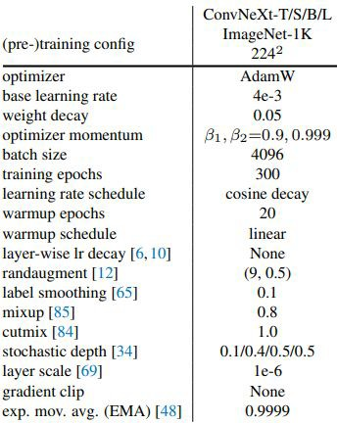
How to tackle overfitting?
There are a lot of different trick to improving your CNN model.
From the recent ConvNeXt paper
What we recommend trying first:
Label Smoothing (huge boost)
Stochastic Depth
DropBlock (paper)
Dropout before final classification layer
Then you can try the others
Check out “Bag of Tricks for Image Classification with Convolutional Neural Networks”
https://arxiv.org/abs/1812.01187

Slide 56
4. Different loss functions and model fine-tuning

Slide 57
How is this different from Face Classification?
same?

Slide 58
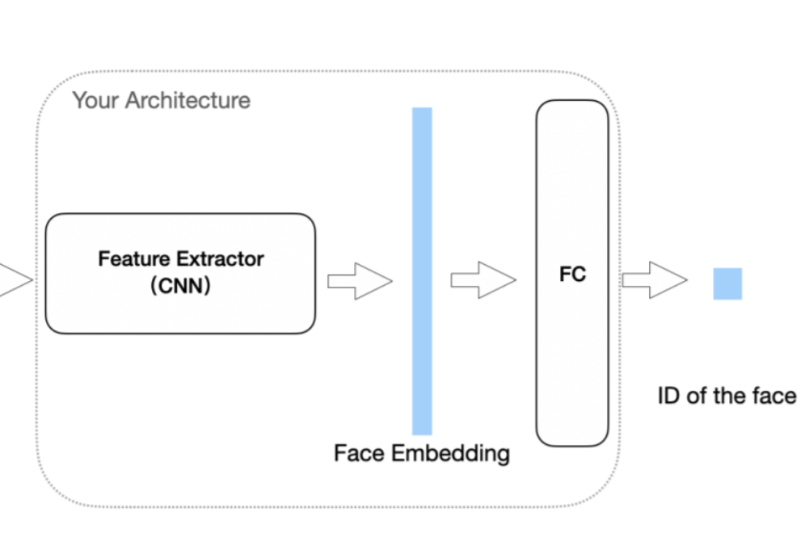
How is this different from Face Classification?

Slide 59
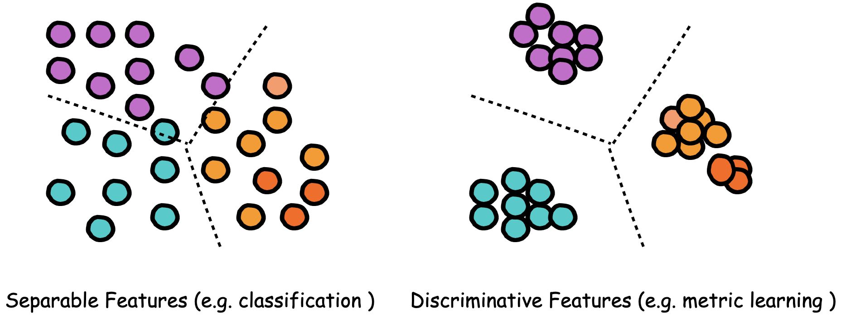
How is this different from Face Classification?

Slide 60
Why classification cannot do verification?
Classifier can only perform closed-set recognition
Need to re-train with open-set new identities everytime
But…we can just use the backbone to extract features and compare features, which does not require classifier
Features learned by the classifier with Cross-Entropy is not discriminative enough

Slide 61
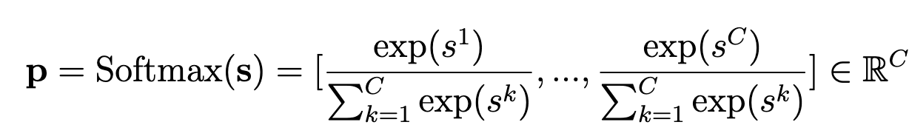
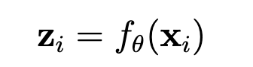
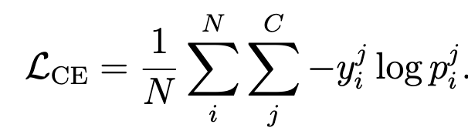
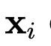
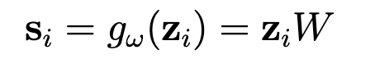
A Closer Look into Cross-Entropy

Slide 62
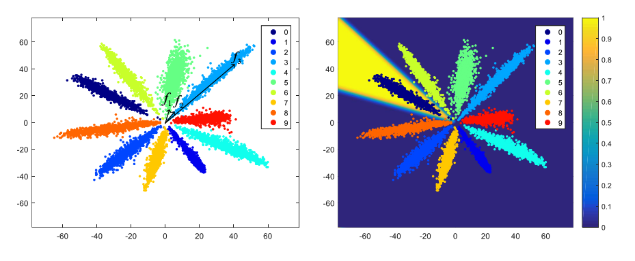
Feature Visualization of Cross-Entropy
NormFace: L2 Hypersphere Embedding for Face Verification. Feng Wang et al.

Slide 63
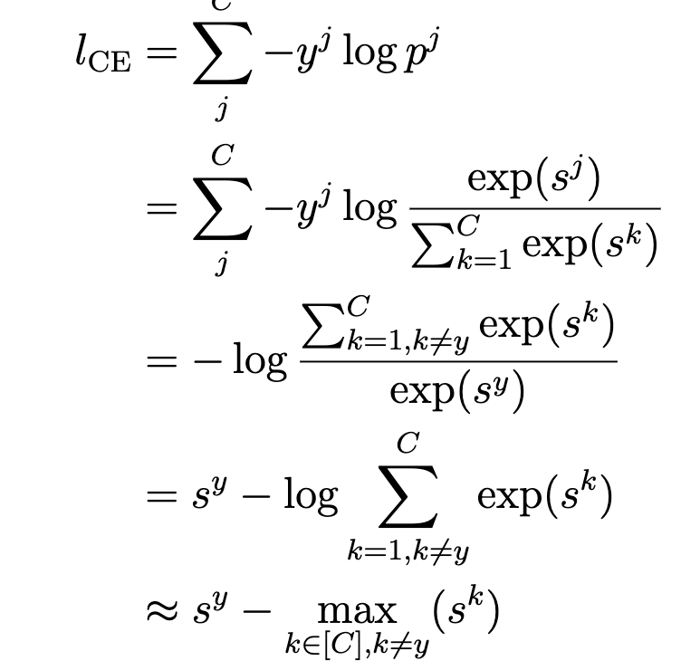
A Closer Look into Cross-Entropy

Slide 64
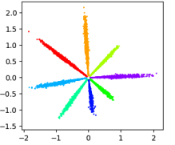
What are better features?
Larger intra-class similarity
(Smaller intra-class distance)
Smaller inter-class similarity
(Larger inter-class distance)

Slide 65
What are better features?
Larger intra-class similarity
(Smaller intra-class distance)
Smaller inter-class similarity
(Larger inter-class distance)
Human language?
Features of the same class have larger similarity (smaller distance) than other classes

Slide 66
How do we enforce the model to learn these discriminative features?
How do we maximize the similarity between “positive”
pairs and minimize the similarity between “negative” pairs?

Slide 67
Two Paradigms
Metric Learning/Pairwise Learning
Margin-based Softmax

Slide 68
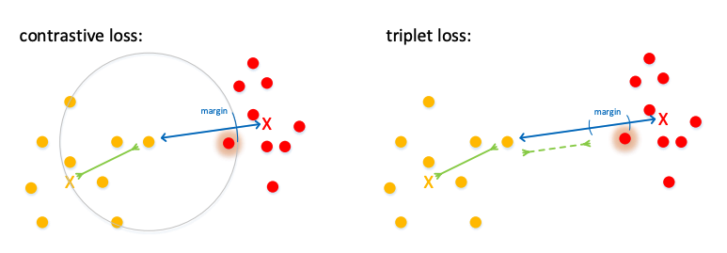
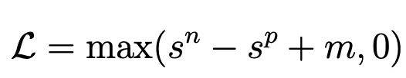
Metric Learning/Pairwise Learning
Centre Loss
Triplet Loss
N-Pair Loss
Contrastive Loss…

Slide 69
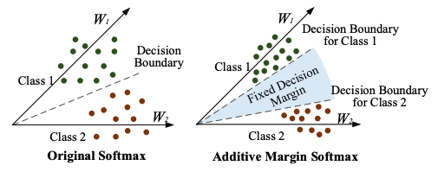
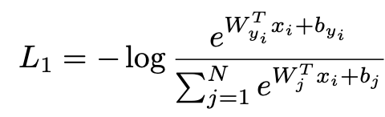
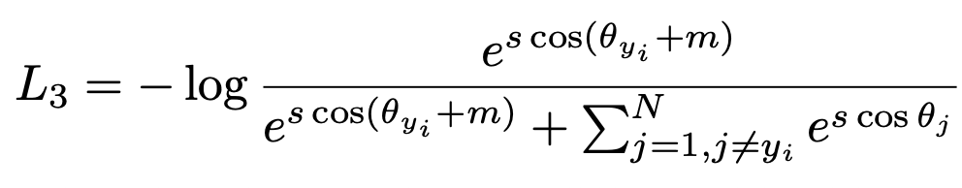
Margin-based Softmax
AM-Softmax
SphereFace
CosFace
ArcFace
CombinedMarginFace
…

Slide 70
How to Get Started
Use a simple network and cross-entropy loss for early deadline
Try better architectures with cross-entropy loss
Try data augmentation
Try other loss functions
Fine-tune your cross-entropy loss with other loss functions

Slide 71
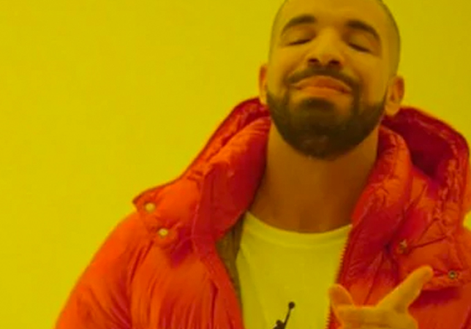
Contrastive Losses
Let’s compute a similarity metric between model embeddings to learn more discriminative features between the input data.

Slide 72
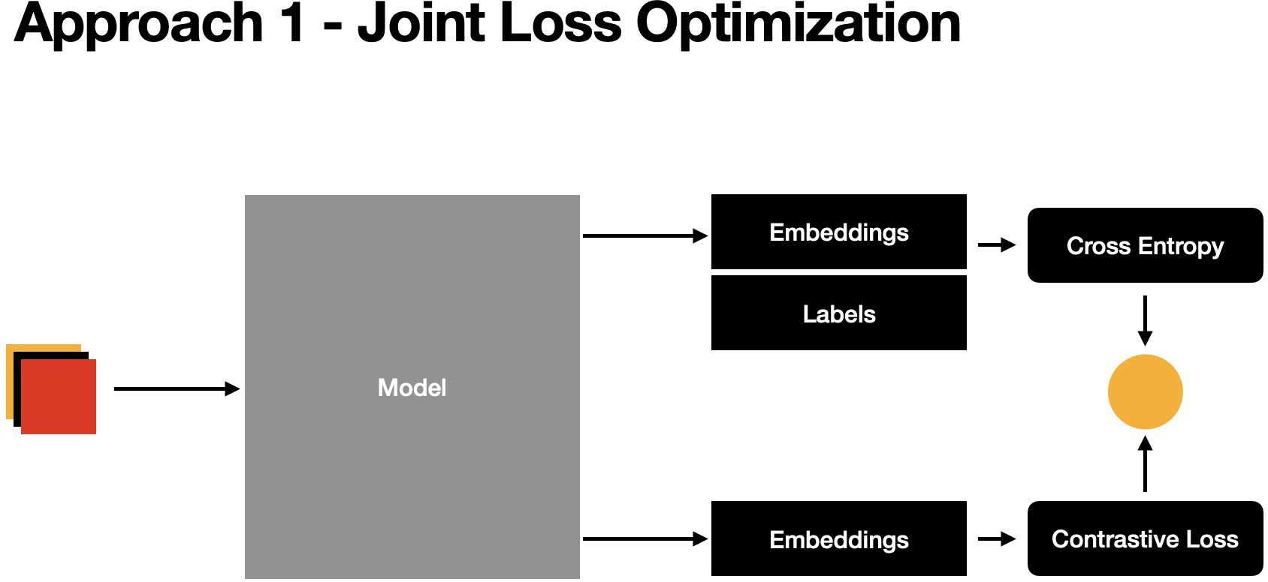

Slide 73


Slide 74
Types of Contrastive Losses
Centre Loss
ArcFace Loss
SphereFace Loss

Slide 75


Slide 76


Slide 77


Slide 78


Slide 79


Slide 80
FAQ

Slide 81
Thanks!
See you on Piazza and in OHs!

